Slide 1

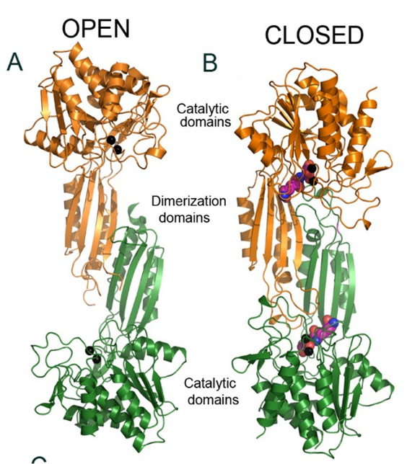
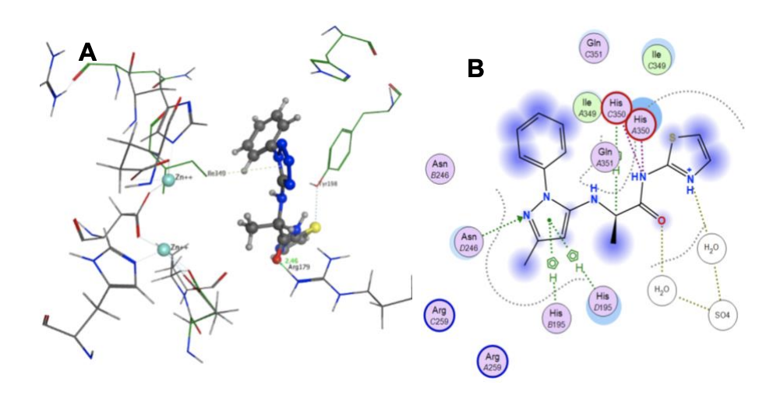
Synthesis of Tetrazole-Based DapE Inhibitors as Potential Antibiotics
Katie Jane Torma, Thahani S. Habeeb Mohammad, and Daniel P. Becker
Department of Chemistry and Biochemistry, Loyola University Chicago, 1068 West Sheridan Road, Chicago, IL 60660
Due to the increase in antibacterial resistance, there is an urgent need for new and novel antibacterial drugs. The target enzyme for this project is the dapE-encoded bacterial enzyme N-succinyl-L,L-diaminopimelic acid desuccinylase (DapE). DapE is a key enzyme in the synthesis of bacterial cellular walls via the lysine biosynthetic pathway. DapE inhibitors should selectively target bacterial DapE which will be lethal to bacteria with no mechanism-based toxicity in humans due to the absence of the lysine biosynthetic pathway in mammals. Thus DapE enzyme is an ideal target for novel antibiotics. The lead molecules identified by the Becker lab via a High-Throughput screen include the tetrazole, (2-[(1-phenyl-1H-tetrazol-5-yl)sulfanyl]-N-(1,3-thiazol-2-yl)propanamide). Synthesis of new analogs of this lead molecule will be described.
Introduction
Synthesis of Pyrazole-based Analog
With the increase in antibacterial resistance, the need for new antibiotics is increasing. Antibiotics work by interfering with a vital function of the bacteria thus killing the bacteria. One way to interfere with a vital cell function is to inhibit the bacterial cell wall formation. The dapE-encoded N-succinyl-L,L-diaminopimelic acid desuccinylase (DapE) enzymes catalyze the hydrolysis of N-succinyl-L,L-diaminopimelic acid (L,L-SDAP) to succinic acid and L,L-diaminopimelate (DAP). Then DAP is converted to m-DAP and ultimately to lysine (Scheme 1). Lysine and mDAP are crucial in bacteria cell wall synthesis. Lysine is an essential amino acid for humans meaning that it has to be ingested and mammals do not make lysine themselves. Since there is no similar pathway in the human body, inhibiting this enzyme would be selectively toxic to bacteria. This enzyme is present in 98% of Gram-negative and in all Gram-positive bacteria. This shows that DapE could serve as a broad-spectrum antibiotic especially when targeting ESKAPE (Enterococcus faecium, Staphylococcus aureus, Klebsiella pneumoniae, Acinetobacter baumannii, Pseudomonas aeruginosa, and Enterobacter species) pathogens. Studies have shown that when the gene encoding the DapE enzyme is deleted the bacteria cannot survive even in a lysine supplemented media.
Scheme 1. DapE catalyzed
reaction
The Becker research lab has obtained five lead molecules through high-throughput screening (HiTS), one being the tetrazole-based analog (Figure 1). Synthesis of the bioisosteric analogs of the tetrazole hit and obtaining their inhibitory potencies using our ninhydrin-based assay will be the focus of this project.
Scheme 2. Synthesis of Pyrazole Analog
The first step in scheme 2 has been successfully completed and the product has been isolated with a 95.5% yield. The second step of this scheme is elaborated on below.
Scheme 3. Buchwald-Hartwig Reaction of 5-OTf pyrazol analog with L-Phenylalanine
Scheme 3 shows one of the Buchwald-Hartwig reactions with L-Phenylalanine as a carboxylic acid while scheme 4 shows L-Phenylalanine methyl ester. The methyl ester analog in scheme 3 has produced many biproducts due to the instability of the L-Phenylalanine methyl ester in the basic medium. Currently working on the best purification process to isolate the desired product.
Figure 1. Tetrazole-based lead molecule.
+
Scheme 4. Buchwald-Hartwig Reaction of 5-OTf pyrazol analog with L-Phenylalanine methyl ester
Background
+
DapE is a homodimeric metalloenzyme and the active sites contain two zinc ions (Figure 2). DapE has two conformations: open and closed. The open to closed conformation is induced by the binding of the substrate. Docking images of tetrazole original lead molecule and the hit-derived pyrazole analog show the interactions with different residues in the DapE active site which is useful to find the pharmacophore of our lead molecule (Figure 3).
Future Work
Figure 3. Interaction (A) Tetrazole original hit and (B) Pyrazole analog with the DapE active site.
The Buchwald-Hartwig reactions produce many biproducts, so I would like to optimize these conditions and purification technique to isolate the desired product. New S_{N}AR conditions will also be employed in the pyrazole analog synthesis. The inhibitor molecules will be tested against DapE using our ninhydrin assay to determine the IC₅₀ values. The final goal of this project is to synthesize a nanomolar potent inhibitor of DapE driven by SAR and Molecular docking.
Figure 2: (A) Open conformation of apo-HiDapE enzyme, (B) Closed conformation of HiDapE products-bound structure.
Sources:
1. Gillner, Danuta M and Becker, D. P. et. al. “Lysine biosynthesis in bacteria: a metallodesuccinylase as a potential antimicrobial target.” J. Biol. Inorg. Chem. 18, 2, 2013, 155-63.
2. Dávid Pajtás, et. al. “Optimization of the Synthesis of Flavone–Amino Acid and Flavone–Dipeptide Hybrids via Buchwald–Hartwig Reaction.” J. Org. Chem., 82, 9, 2017, 4578-4587.
3. Nocek, B.; Reidl, C.; Heath, T.; Becker, D. P. et. al. “Structural Evidence for a Major Conformational Change Triggered by Substrate Binding in DapE Enzymes: Impact on the Catalytic Mechanism.” Biochemistry (N. Y.) 2018, 57, 574.

